Slide 1


Capstone Project -- Fintelligence

Slide 2
Introduction
Lending Club is the world's largest peer-to-peer lending online platform that connects borrowers and lenders. the global P2P lending market was in 2005 with the launch of the British P2P lending company Zopa. In 2007, Lending Club was one of the first companies to bring P2P lending to the United States. The P2P lending market was quite small at the time, worth only a few million dollars, but enjoying exponential growth.
By early 2008, the P2P lending market was over $100 million and climbing, and it began to look like P2P lending would eventually overtake traditional bank loans. The first signs of weakness struck in 2016 after an increase in interest rates made other investment vehicles more popular, and rising rates of borrower default began to cut into returns and investor confidence. Growth began to falter, and Lending Club, which was muddling through a scandal and a change in leadership, entered a three-year slide in share prices. The P2P lending market continues to grow, but the conditions have been made clear: lending platforms like Lending Club are accountable to investor needs, including ensuring good rates of return, and minimizing risk.

Slide 3
Introduction
Lending Club’s business model works by making lending more efficient, and thereby making available better investor returns and faster, cheaper loans for borrowers at the same time. This is achieved by a combination of reduced overhead from cutting out the middle-man, and a faster and supposedly more accurate way of determining borrower reliability. The loans average around $8,000 and are typically used to refinance expensive credit card debt. personal loans of up to $40,000 on either a 3-year or 5-year term. Investors can then browse loan listings on the website and select loans they want to invest in based on a myriad of variables such as amount of loan, purpose of loan, loan grade, fico score etc.
The average interest rate over all loans is 12.3%, but after factoring in early repayment, loan defaults, and platform fees, investors average a 5% annual return. For lenders owning more than one hundred notes, returns can be fairly consistent (low volatility), but for those investing in just a few loans, the returns can vary wildly, ranging from above 10% to subzero (negative) returns.

Slide 4
Lending Club’s Weakness:
accountability to investors, ensuring good rates of return, and minimizing risk.

Slide 5
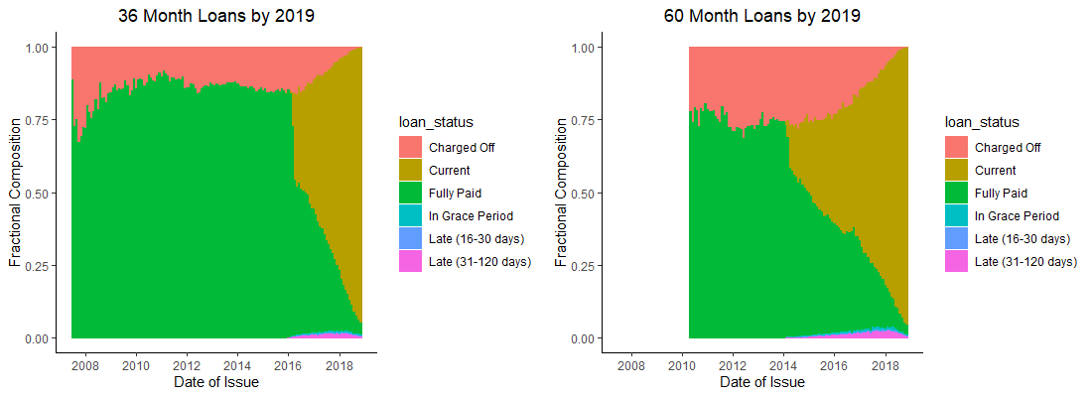
What Makes a Good Portfolio?

Slide 6
Goal
The goal of this project is to build a machine learning model to predict the probability that a loan will charge off. Which could help Lending Club investors make better-informed investment decisions.

Slide 7
Data
The data used for this analysis includes from 2007 up to 2018 Q4 -- 1345310
rows and 152 columns.

Slide 8
Data Analysis
To explore this issue, we must first understand the basics and how Lending Club works. Lending club assigns grades to loans as an indicator of risk. Grade A is considered to be the safest or least risk with high FICO score, while Grade G loans have the most risk with low FICO score.

Slide 9
Data Analysis “Charged off” loan amount of is highly distributed

Slide 10
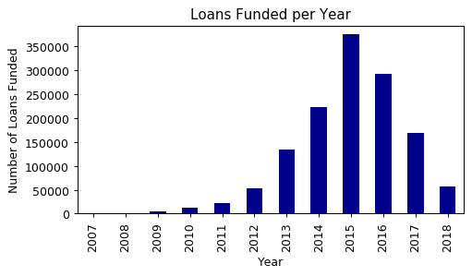
Data Analysis Grade A~C still has lots of “Charged Off” portion

Slide 11
Data Analysis Interest rates have changed over time across loan various loan grades. The safer loans -- Grades A,B,C seem to be relatively consistent. However, as you can see, interest rates have been rising for the riskier grades, as high as 30%! The safer loans (grades A,B,C) seem to have consistent default rates but the riskier grades (E,F,G) are trending toward higher default rates.

Slide 12
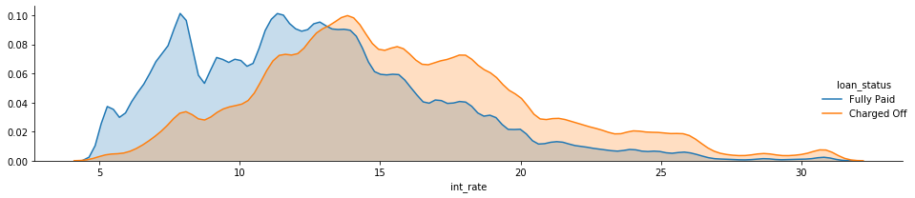
Data Analysis nterest rate between “fully paid” and “charged off”

Slide 13
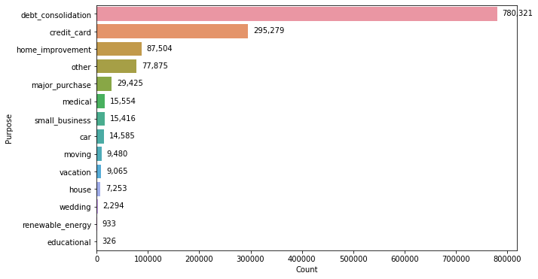
Loan purpose debt consolidation is the most common reason for borrowing. The greatest advantage of peer to peer lending is the low cost, so loans issued by LC usually charge lower interest rates compared with money provided by traditional banks. Most consumers choose to consolidate debt to enjoy lower borrowing costs. Debt consolidation, credit card, house and small business are the most popular reasons for borrowing.

Slide 14
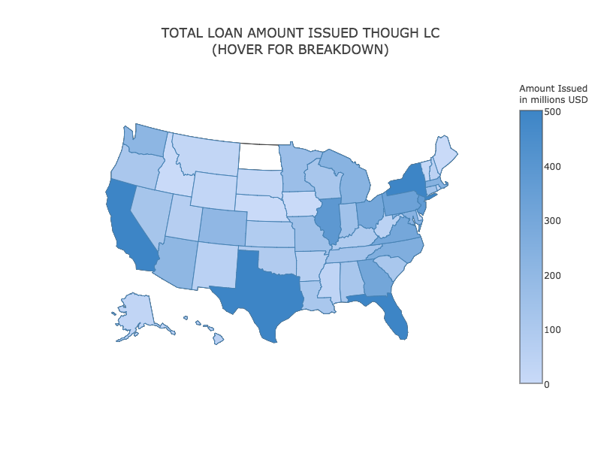
Geographical Distribution of Issued Loans From a geographical perspective, California, Texas, New York, Florida have the largest dollar amount and volume of loans.

Slide 15
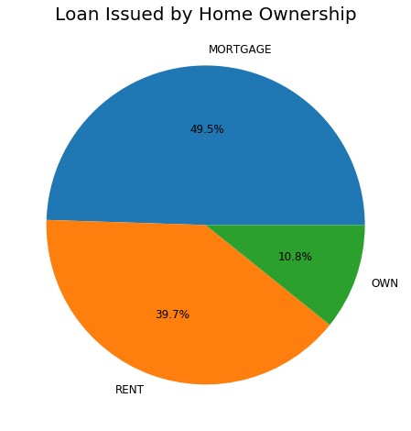
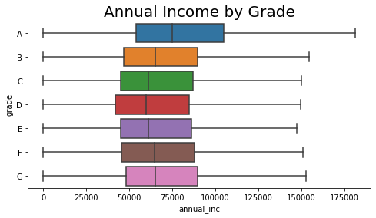
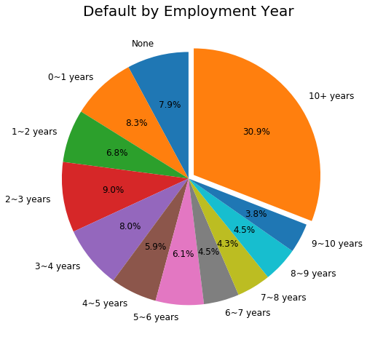
Potential lender The borrower's personal information (Annual income, DTI, employment length and home ownership status)

Slide 16
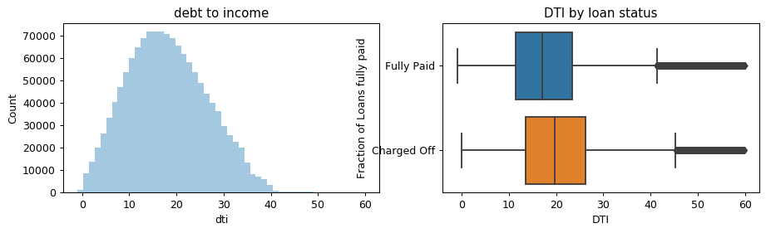
DTI The lower the better, a DTI of 10 means your debts payment excluding mortgage, are only 10% of your gross income. Overall DTI has some impact on charge off probabilities.

Slide 17
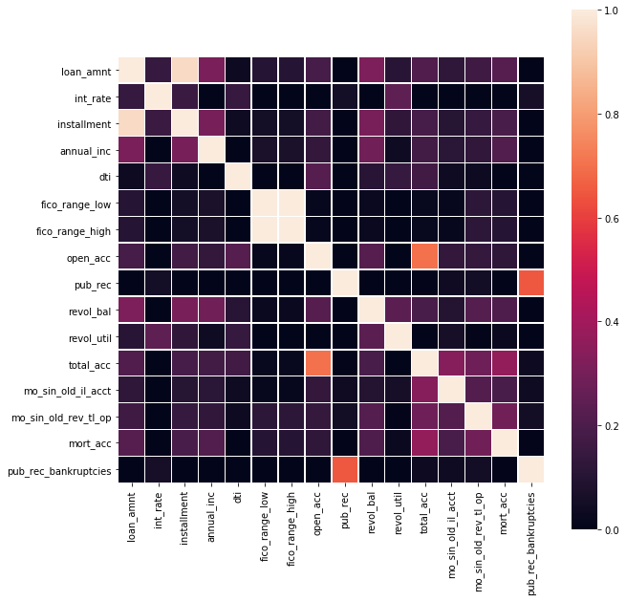
Features Correlation Drop the features that would have not been available before a load was lend

Slide 18
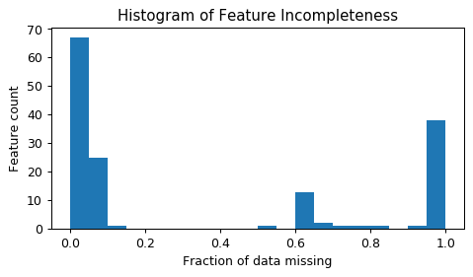
Data preprocessing Imputing missing data
Drop features missing more than 70% data

Slide 19
Feature Engineering
Visualization with count distributions, bar plot & KDE plot with faceting on the loan status
Drop useless features
Remove outliers
Cleaning & Formatting (e.g., "emp_length")
Log Transformation: Transformation of features (e.g. log transformation of average of "fico_score")
Creating new features ( e.g.”fico_score”)
Encoding ( e.g.“grade”, “home ownership”, and “paid_flag”)
Dummy features
Feature selection
”fully paid” and “charged off” data split by 80% and 20% for train and test dataset

Slide 20
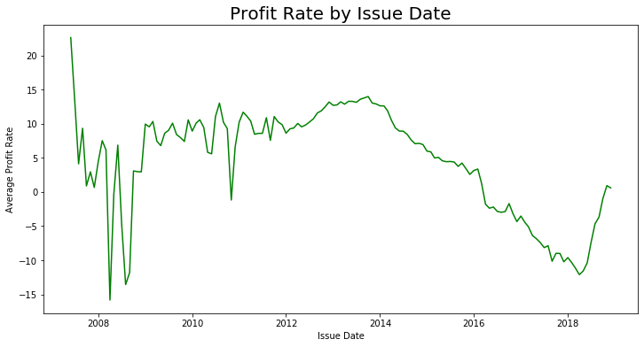
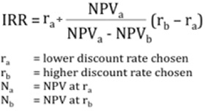
Becoming a confident investor takes skill, not secrets

Slide 21
Modeling work processed by several cases (w/ 7 Algorithms)
“ Data purification ”
Remove outliers
Remove variables updating after loan status (Total pymnt,..)
Ver.1
(Use all features - 150)
Ver.2
(Use 145 features)
Ver.3
(Use 95 features)
Accuracy : 1
0.67 ~0.74
0.63 ~ 0.74
“ Feature Selection ”
Ver.4
(Use 20 features)
Based on feature importance (4 Algorithms)
“ Stacking ”
(7 Algorithms)
0.61 ~ 0.73
Final (Ver.7)
(Use 40 features)
Ver.6
(Use 40 features)
Ver.5
(Use 42 features)
0.67
0.56 ~ 0.67
0.61 ~ 0.74
Remove again 2 variables suspected to be updated after loan status (tot_rec_int, total_rec_late_fee)

Slide 22
Feature selection based on the importance from 4 Algorithms
[ Model fitting & Feature importance ⥤ Feature selection ]
Features | RF Rank | GBM Rank | XGB Rank | SVM Rank | Avg. Rank | Importance Group
sub_grade_num | 2 | 1 | 10 | 1 | 1 | Group 1 (1st tier)
int_rate | 4 | 4 | 5 | 2 | 2
total_rec_int | 3 | 8 | 4 | 3 | 3
loan_amnt | 13 | 7 | 3 | 9 | 4
installment | 15 | 6 | 2 | 11 | 5
… | … | … | … | … | …
max_bal_bc | 21 | 29 | 22 | 17 | 20
mths_since_last_delinq | 29 | 30 | 18 | 23 | 21 | Group 2 (2nd tier)
revol_util | 28 | 26 | 21 | 29 | 22
revol_bal | 34 | 24 | 19 | 35 | 23
mths_since_rcnt_il | 32 | 37 | 27 | 14 | 24
… | … | … | … | … | …
grade_D | 11 | 20 | 75 | 36 | 40
Modeling
(Ver.4)
Data
(Cleaned)
Top 20 Features
Modeling
(Ver.5)
Top 40 Features

Slide 23
[Back-up] Logistic Regression
Model result
Feature Importance (Top 20)
Prediction Accuracy : 66% (0.65569)
Predicted
 | Charged Off | Fully Paid
Charged Off | 10,491 | 8,110
Fully Paid | 5,661 | 15,734
Actual
[ ROC ]
No | Important Features
1 | sub_grade_num
2 | int_rate
3 | acc_open_past_24mths
4 | num_rev_tl_bal_gt_0
5 | open_rv_24m

Slide 24
[Back-up] Random Forest
Model result
Feature Importance (Top 20)
Prediction Accuracy : 66% (0.6584)
Predicted
 | Charged Off | Fully Paid
Charged Off | 11,076 | 7,525
Fully Paid | 6,149 | 15,246
Actual
[ ROC ]
No | Important Features
1 | sub_grade_num
2 | int_rate
3 | term_ 60 months
4 | fico_range_mean
5 | dti

Slide 25
[Back-up] Gradient Boosting
Model result
Feature Importance (Top 20)
Prediction Accuracy : 66% (0.66095)
Predicted
 | Charged Off | Fully Paid
Charged Off | 10,754 | 7,675
Fully Paid | 5,887 | 15,684
Actual
[ ROC ]
No | Important Features
1 | term_ 60 months
2 | sub_grade_num
3 | installment
4 | bc_open_to_buy
5 | all_util

Slide 26
[Back-up] XGBoost
Model result
Feature Importance (Top 20)
Prediction Accuracy : 67% (0.6656)
Predicted
 | Charged Off | Fully Paid
Charged Off | 11,331 | 7,270
Fully Paid | 6,106 | 15,289
Actual
[ ROC ]
No | Important Features
1 | int_rate
2 | annual_inc
3 | mo_sin_old_rev_tl_op
4 | dti
5 | Loan_amnt

Slide 27
[Back-up] Support Vector Machine (Linear)
Model result
Feature Importance (Top 20)
Prediction Accuracy : 56% (0.5569)
Predicted
 | Charged Off | Fully Paid
Charged Off | 4,125 | 14,476
Fully Paid | 3,248 | 18,147
Actual
[ ROC ]
No | Important Features
1 | sub_grade_num
2 | int_rate
3 | dti
4 | mths_since_recent_inq
5 | acc_open_past_24mths

Slide 28
[Back-up] Naive Bayes (GaussianNB)
Model result
Feature Importance (Top 20)
Prediction Accuracy : 58% (0.5844)
Predicted
GaussianNB Doesn’t have
Feature Importance
 | Charged Off | Fully Paid
Charged Off | 14,270 | 4,331
Fully Paid | 12,291 | 9,104
Actual
[ ROC ]

Slide 29
[Back-up] Neural Net
Model result
Feature Importance (Top 20)
Prediction Accuracy : 47% (0.4690)
Predicted
 | Charged Off | Fully Paid
Charged Off | 18,506 | 95
Fully Paid | 21,144 | 251
Actual
[ ROC ]
No | Important Features
1 | term_60_months
2 | sub_grade_num
3 | fico_range_mean
4 | pct_tl_nvr_dlq
5 | Mths_since_recent_inq

Slide 30
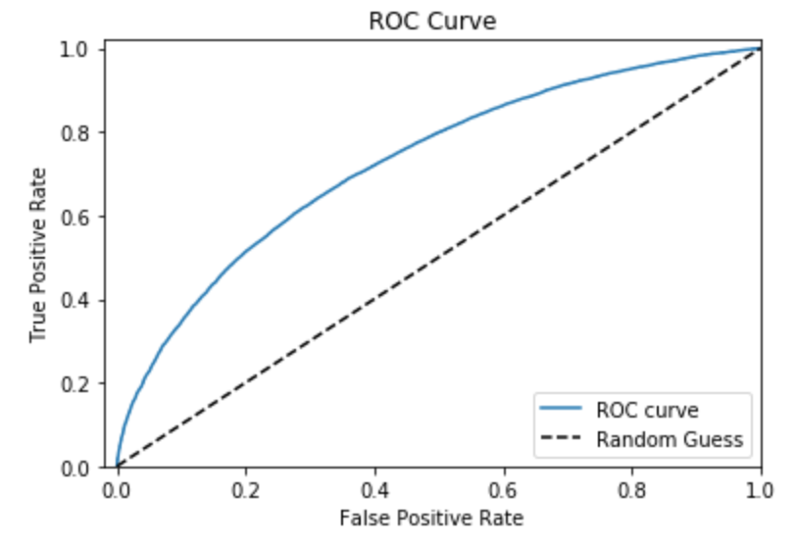
[ Stacking Model ]
Stacking Model
Result
Rank | Model | Accuracy
1 | Logistic Regression | 66.57%
2 | XGBoost | 66.56%
3 | Gradient Boosting | 66.09%
4 | Random Forest | 65.84%
5 | Naive Bayes | 58.44%
6 | Support Vector | 55.69%
7 | Neural Net | 46.90%
Predicted
 | Charged Off | Fully Paid
Charged Off | 10,872 | 7,461
Fully Paid | 5,933 | 15,734
Actual
Stacking
XGBoost
Gradient
Boosting
Random
Forest
Logistic
Regression
Accuracy : 66.80%

Slide 31
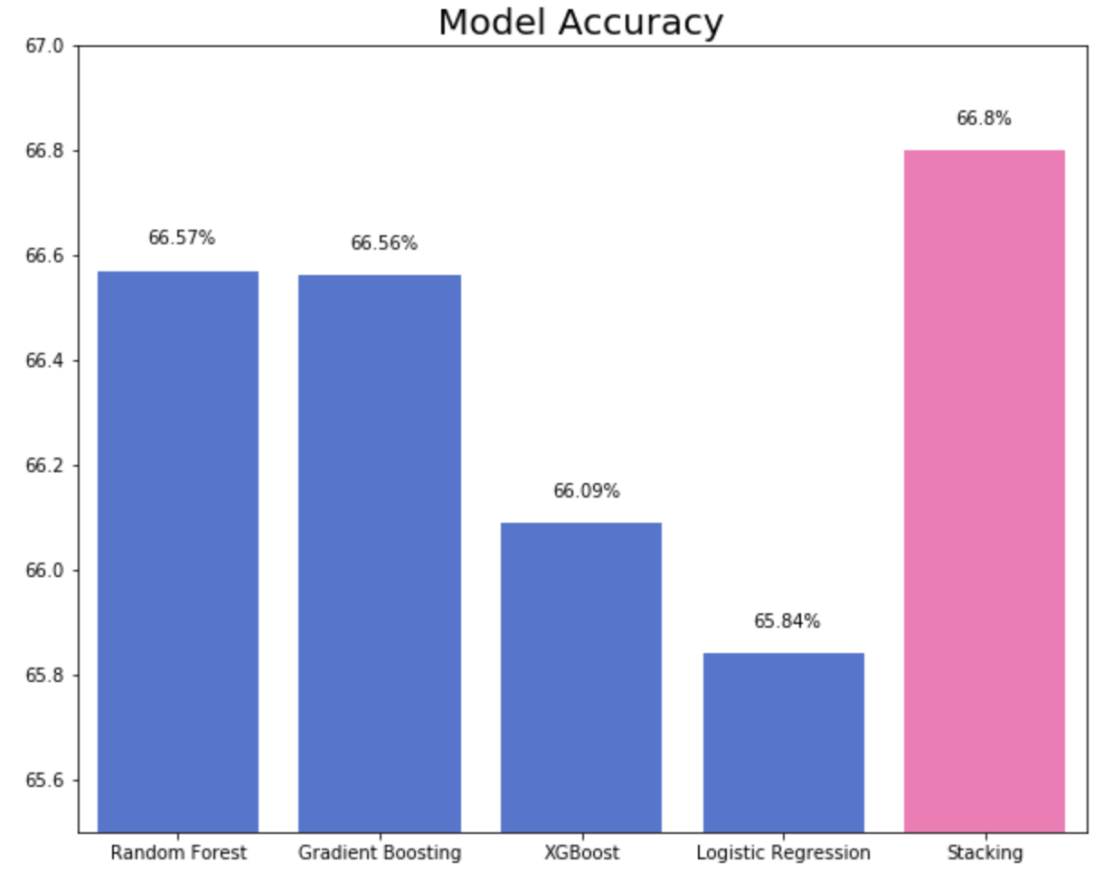
[ Summary ]
Model Comparison
Top Features
Rank | Name | Desc
1 | sub_grade | A1, A2,…, G3, G4
1 | dti | Debt To Income ratio
1 | installment | The monthly payment
2 | int_rate | Interest Rate on the loan
2 | term_ 60 months | month of payment
3 | acc_open_past_24mths | -
3 | num_rev_tl_bal_gt_0 | -
3 | open_rv_24m | -
3 | mort_acc | -
3 | open_acc_6m | -

Slide 32
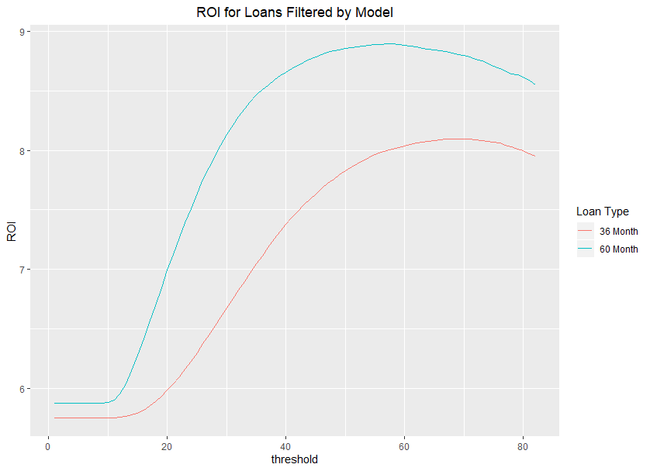
Implications of the Model
Realistic Behavior
Significant Improvements to portfolio returns
Range of possible thresholds

Slide 33
Future work
Classification modeling has produced insight on avoiding loans which will likely default, but does not identify the best possible portfolio.
What are the discriminants of lucrative loans?
Could a regression model help identify the best portfolio?

Slide 34
Questions
Thank you ☺
Emails
Aaron Festinger: aaron.Festinger@gmail.com
Alex Guyton : thealexguyton@gmail.com
Heesuk Gwak: hskwak@gamil.com
Sean Hong: longbyn@gmail.com
Yan Mu: dannamu2017@gmail.com

